Slide 1
Quick Warm-up Exercise
Lecture 1 Recap

Slide 2
Quick Warm-up Exercise:
Python Basics, Types, Variables
Lecture 2 Recap Exercise

Slide 3
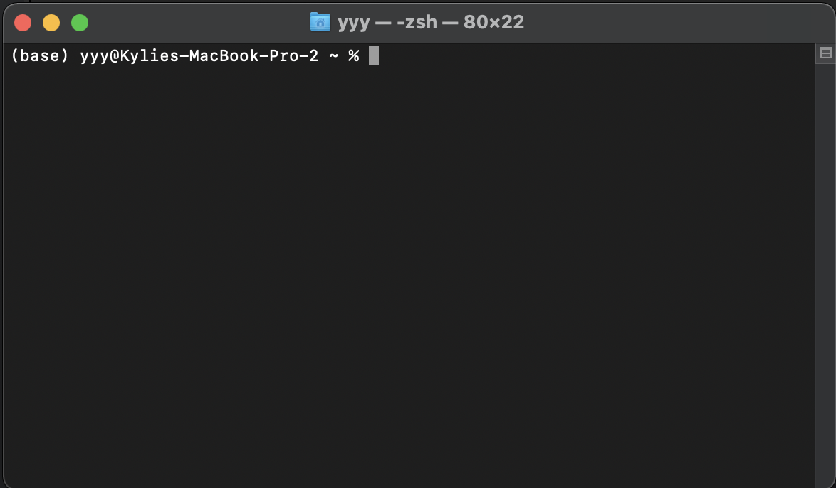
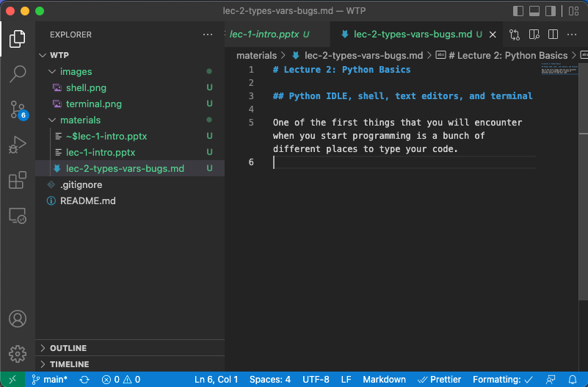
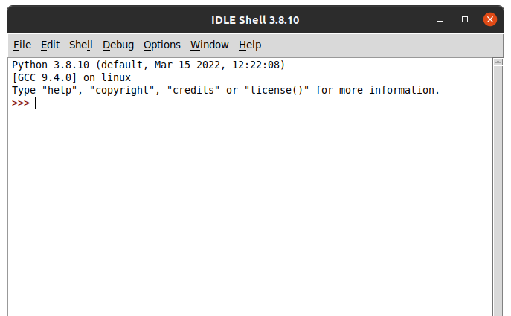
Match Each to an Image!
1. IDE
(text editor for script-writing)
2. Shell
(chat box with software)
3. Terminal
(interacts with files, run scripts)
A
B
C

Slide 4
Match Each to an Image!
1. IDE
(text editor for script-writing)
2. Shell
(chat box with software)
3. Terminal
(interacts with files, run scripts)
A
B
C

Slide 5
Types: what happens if you print each of these?
1. type(“Glaciers are cool!”)
str
2. type(“5”)
str
3. type(5)
int
4. type(“5.”)
str
5. type(100.)
float
6. type(5>100.)
bool
7. type(None)
NoneType

Slide 6
Typecasting
5.0 Yes!
5 No
5.0 Yes!
5.0 Yes!
What could have resulted in 5.0?
print(5.0)
print(int(5.0))
print(float(5))
print(str(5.))

Slide 7
Quick Warm-up Exercise:
Conditionals and More Types
Lecture 3 Recap Exercise

Slide 8
Sequences: what happens if you print each of these?
1. [“a”, “b”, “c”, “d”][2]
c
2. type((0,3))
tuple
3. type({“mark”:[”target”, ”sign”]})
dict
4. len([100,100,200])
3
5. “apple” in [“orange”, ”lemon”]
False
6. “apple” not in [“orange”, “lemon”]
True

Slide 9
Conditionals: what will this code print?
x = 4 ** 2
if 5 > x:
print(“A”)
else:
print(“B”)
print(“C”)
if x >= 0 and not (x==6):
print(“D”)
B
C
D

Slide 10
Quick Warm-up Exercise:
Loops
Lecture 4 Recap Exercise

Slide 11
Loops: what will this code print?
x = set()
for i in range(5):
x.add(4*i)
if len(x) == 3:
break
print(x)
A set containing the values {0, 4, 8}
(but not necessarily in that order!)

Slide 12
Loops: what will this code print?
food_ratings = {'apple': 'C', 'orange': 'A', 'mango': 'S'}
for fruit in food_ratings:
if food_ratings[fruit] == 'S':
print("I love " + fruit + "!")
else:
print("I think " + fruit + " is okay.")
I think apple is okay.
I think orange is okay.
I love mango!

Slide 13
Quick Warm-up Exercise:
Functions
Lecture 5 Recap Exercise

Slide 14
Functions: guess the function!
Oomi will run a function on any list of numbers that you enter into the Zoom chat.
Start entering lists!
This function will print a number for each input. (*If the input list is empty, it prints 0.)
The first person to guess what the function does wins!

Slide 15
Quick Warm-up Exercise:
Classes
Lecture 6 Recap Exercise

Slide 16
Class or Instance?
class Atom:
mass = 0
def __init__(self, name, atomic_number, mass):
self.name = name
self.atomic_number = atomic_number
self.mass = mass
a = Atom(“hydrogen”, 1, 1.00784)
print(Atom.mass)
print(a.mass)
0
1.00784

